Slide 1
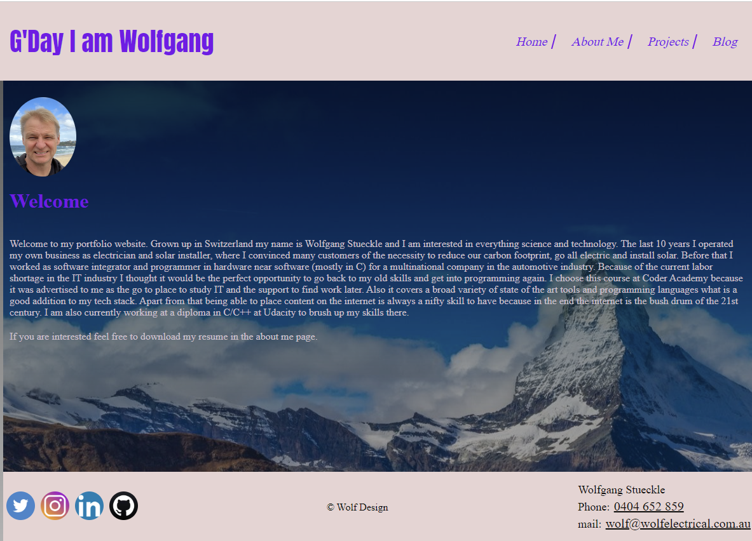
Portfolio walk through, Landing
Notes:
Landing page

Slide 2
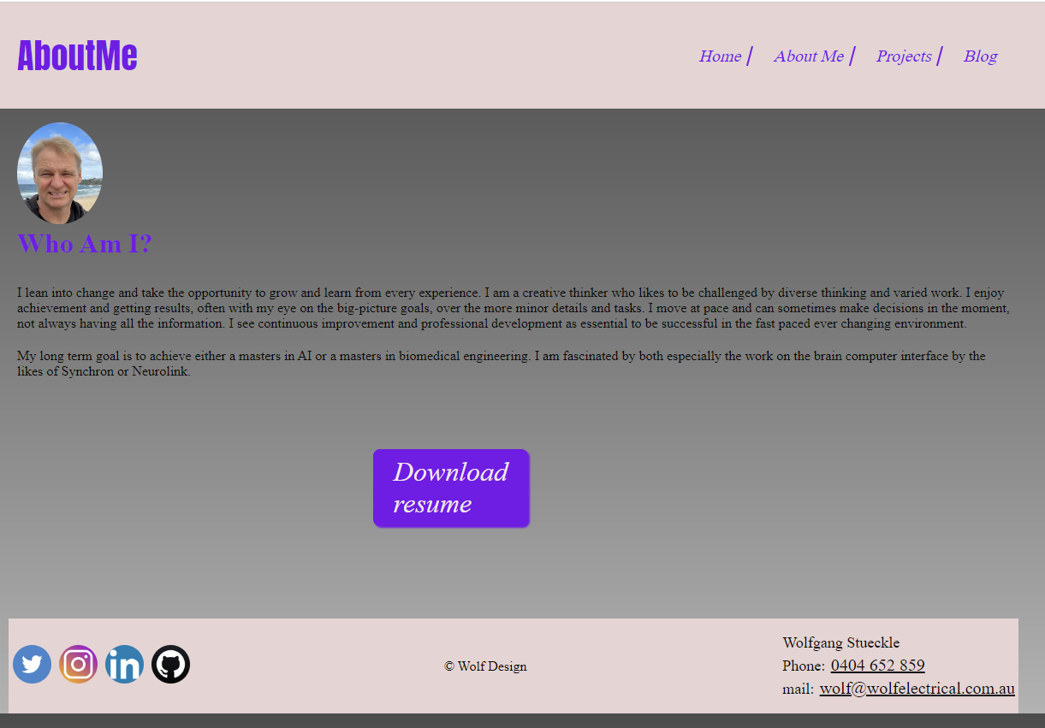
About Me
Notes:
Landing page

Slide 3
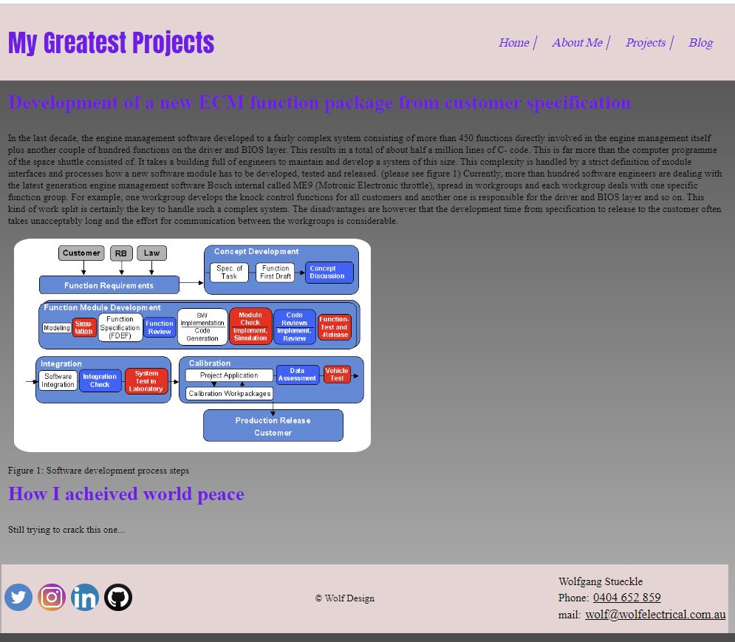
Projects
Notes:
Landing page

Slide 4
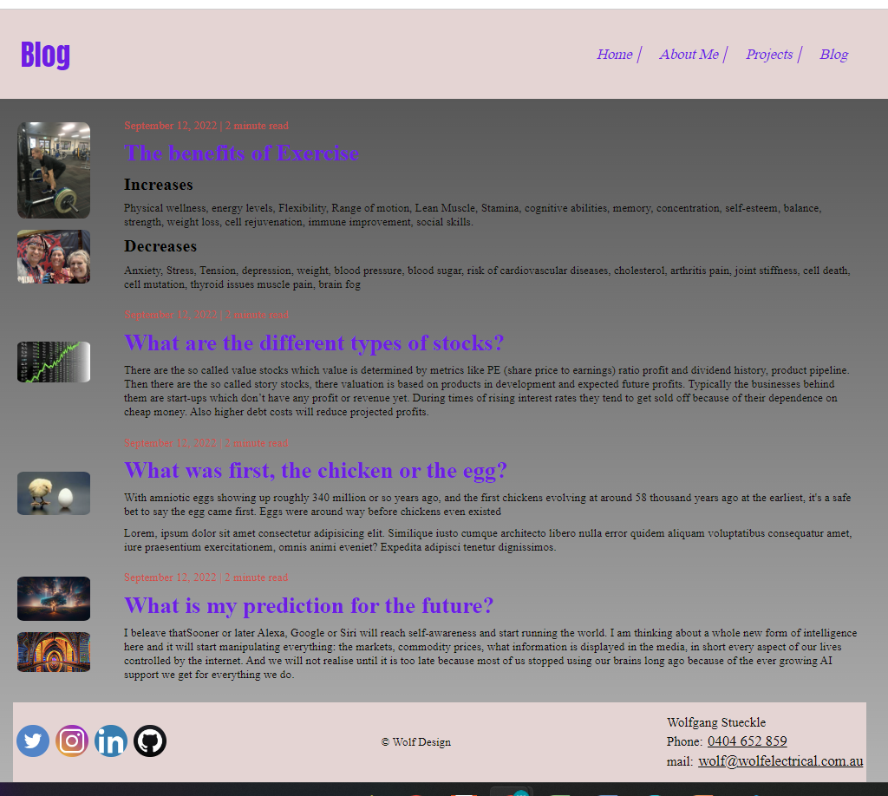
Blog
Notes:
Landing page

Slide 5
Design process and decision making
Looked at multiple web designs and got inspiration for coding.
I tried to get the best of all of them

Slide 6
Development process review
Challenges: making the flex box work for the small devices.
Ethical issues: not as I am aware off.
Favourite parts: designing the graphic elements

